Slide 1
VIDEO
Q&A
Engage, Learn, Connect: Unlocking Knowledge through Video Q&A

Slide 2
PROBLEM STATEMENT
Enable users to ask questions related to video content.
Enhance user engagement and interaction with video content.
Utilize AI technology to provide accurate answers to user queries.

Slide 3
FUNCTIONALITIES
Video Hosting
Question Submission
AI Question Analysis
Content Understanding
User Engagement
User-Friendly Interface
Automated Responses

Slide 4
01
SAVES TIME
02
PERSONALIZED LEARNING
ADVANTAGES
03
ACCESSIBILITY TOOLS
04
DEBUGGING
05
INSIGHTS

Slide 5
TECHNOLOGIES USED
FRONTEND-HTML,CSS,JAVASCRIPT
BACKEND-NODE JS
GOOGLE CLOUD
MULTIMODELGEMINI
VERTEXAI PLATFORM
VIDEO Q&A SERVICE

Slide 6
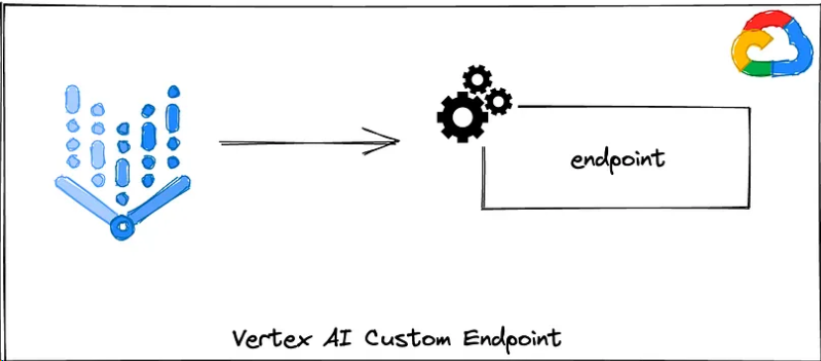
WORK FLOW

Slide 7
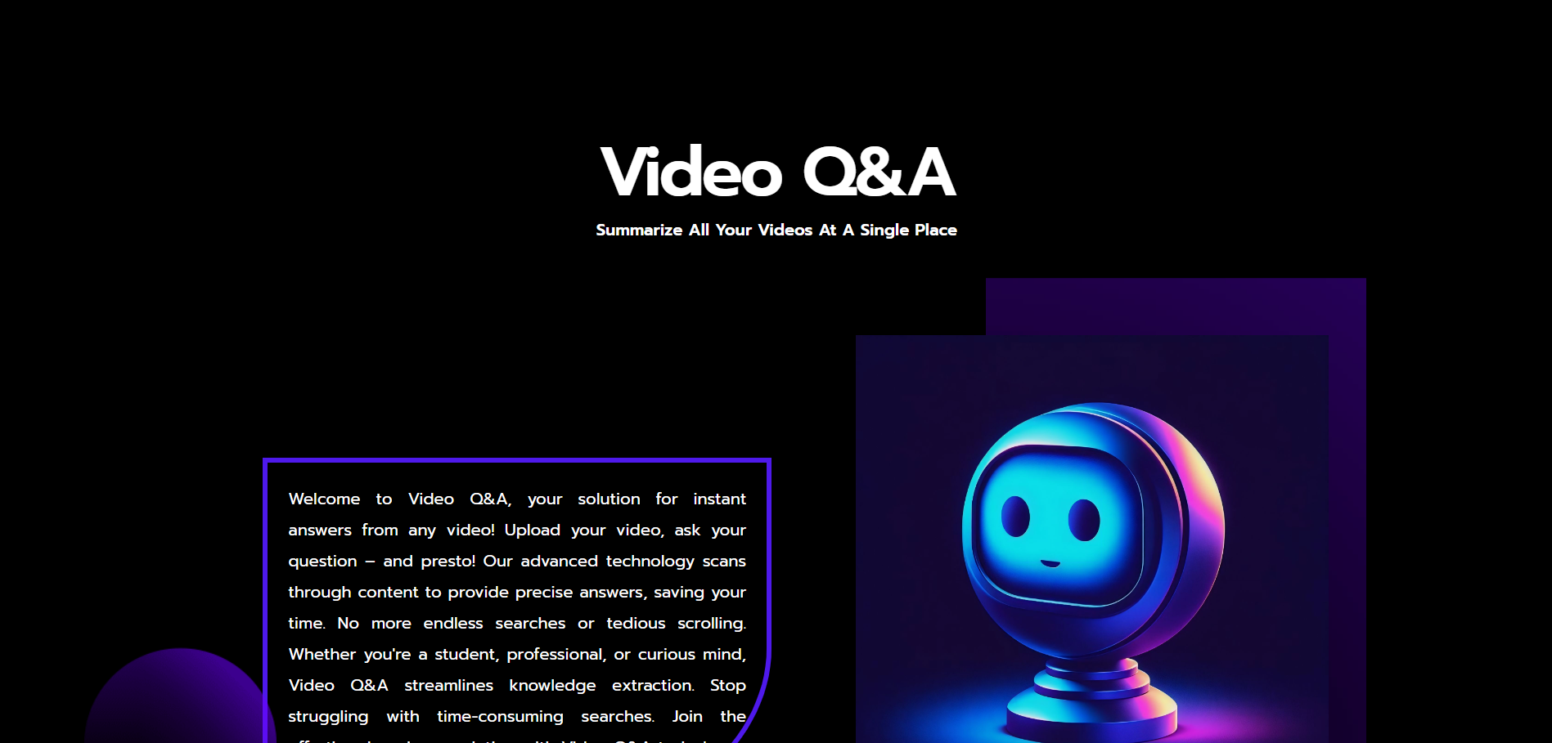
FRONT END

Slide 8

FRONT END

Slide 9
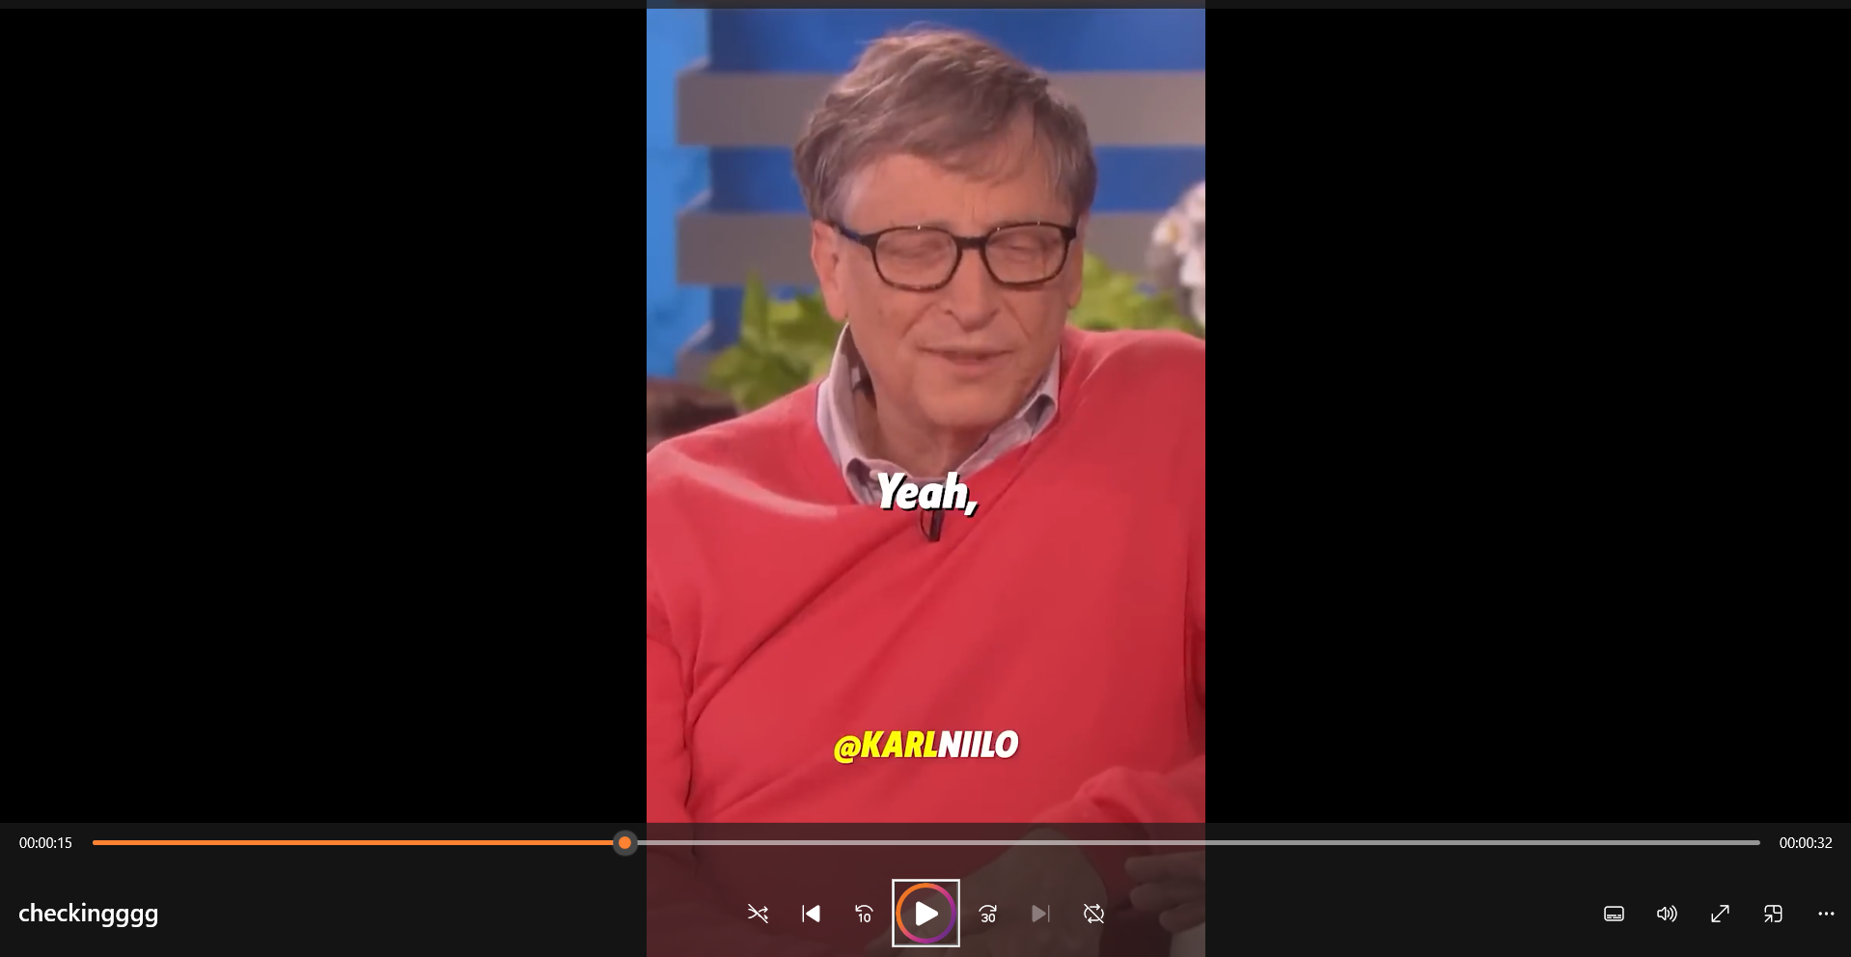
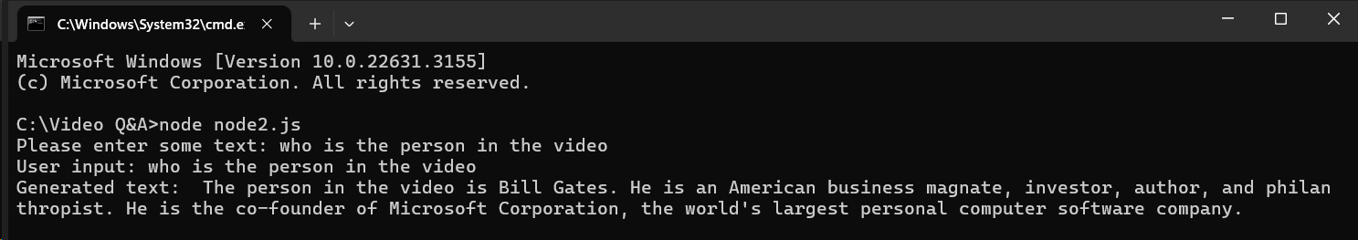
BACKEND

Slide 10
APPLICATIONS
Sports Performance Enhancement
Medical Diagnosis Support
Video Forensics
Virtual Reality (VR) Scripting with Video Analysis

Slide 11
FUTURE ENHANCEMENTS
HYPERLINK
Enabling users to give hyperlink of the video.
CYBER SECURITY
Authenticating the user
FEEDBACK MECHANISM
Adding feedback responses to website
INPUT VALIDATION
Making the upload video size to more than 7MB

Slide 12
THANK YOU

